Slide 1


Slide 2

GROUP-2
HARSHIT SAMAR | 2020A7PS0964G
ANUSHEEL SOLANKI | 2020B3A70541G
ASHRAY KASHYAP | 2020B3A70494G
MUHAMMED JIBRAN | 2020B3A70367G

Slide 3
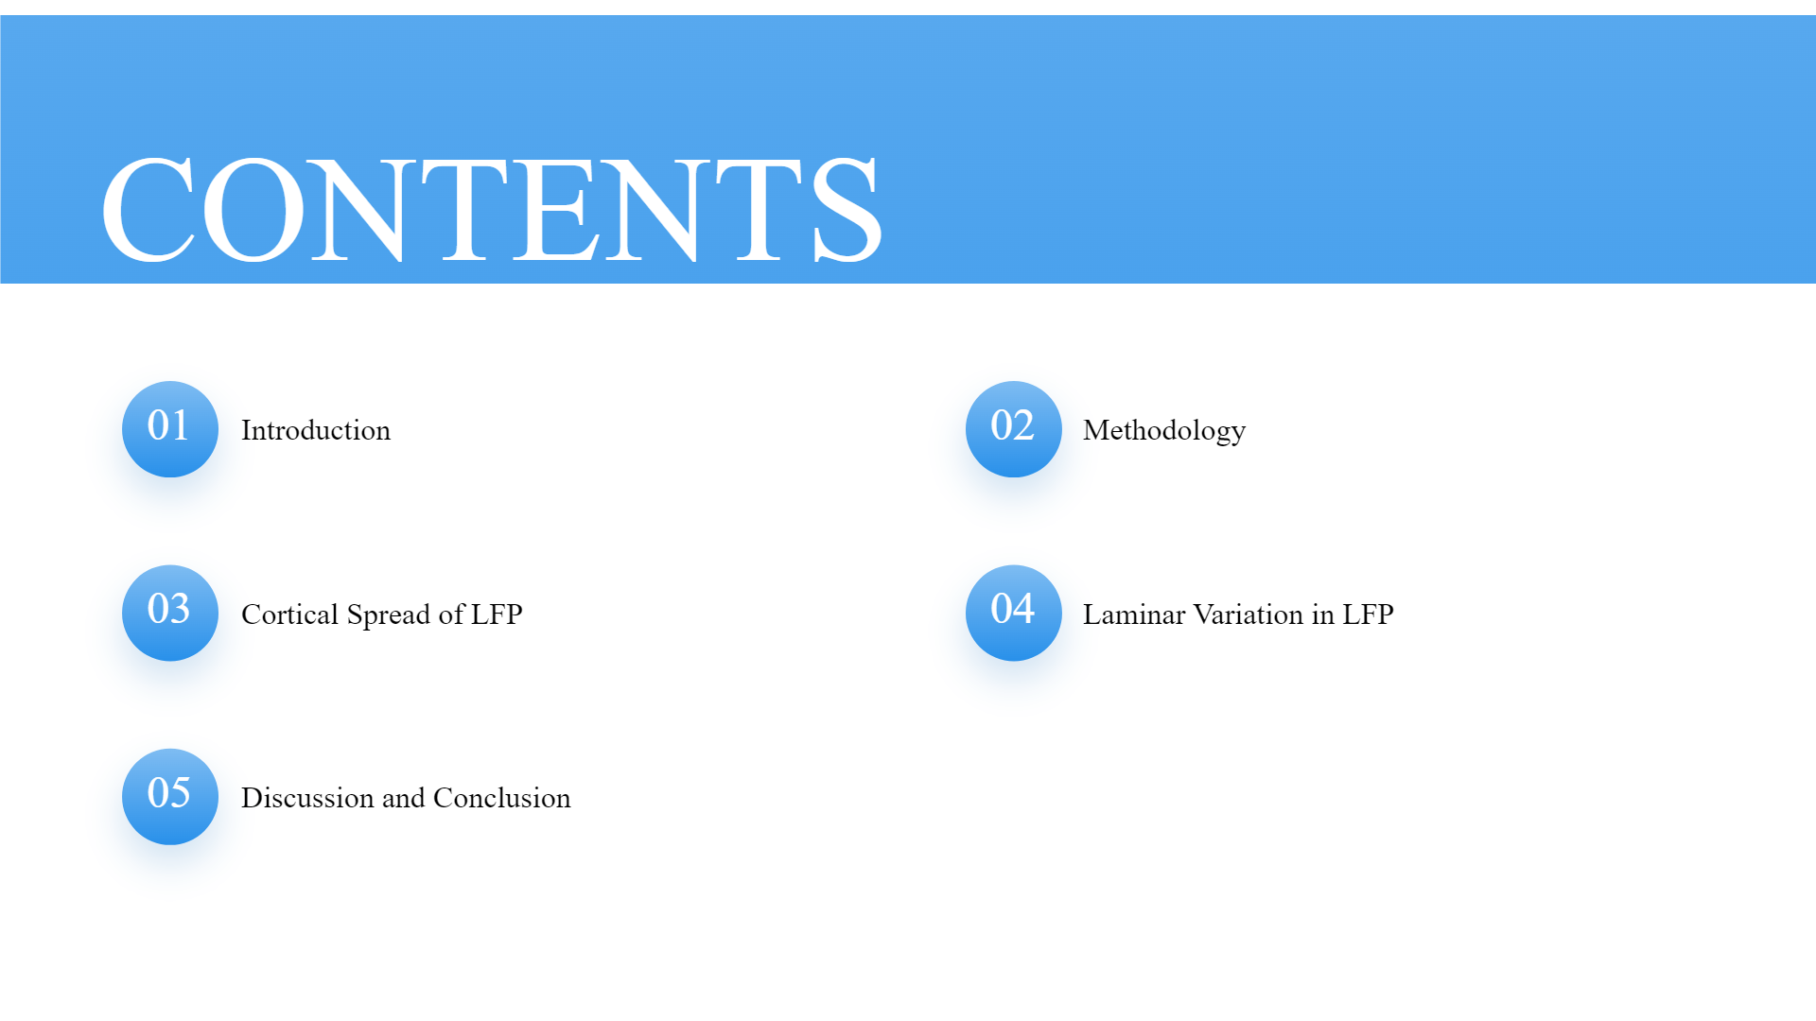

Results
References

Slide 4


Slide 5


The electrical potential recorded from a small region of neural tissue, typically using electrodes placed in or near the brain.
The simultaneous firing of multiple neurons in a specific brain region. MUA recordings typically involve using microelectrodes or electrode arrays to detect the action potentials (spikes) generated by neurons.

Slide 6




Why to study? (Motivation)
The LFP is of interest because:
LFP is thought to sum the activity from many neurons revealing neuronal activity at the population level
The population activity measured by the LFP may be related to the BOLD signal in fMRI
LFP has become a candidate signal for neural prostheses because it is easier to record and more tolerant to recording position compared with spike activity
🤔
An important outstanding question is, what is the cortical spread of the LFP, or how far can the LFP propagate in cortical tissue?

Slide 7


Slide 8
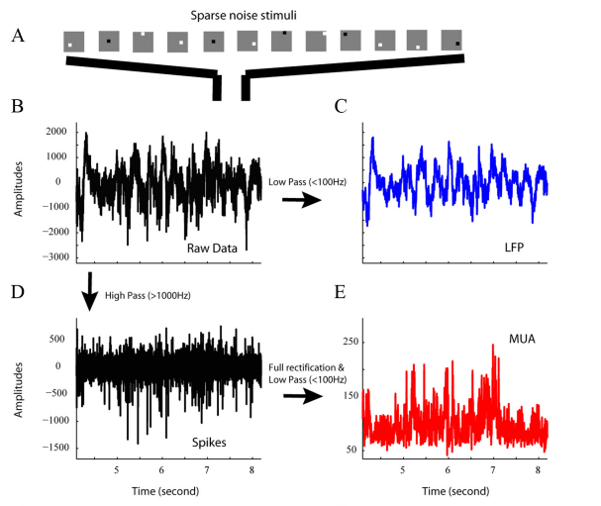
Experiment Setup
Seven independently movable electrodes were inserted in the brain of an Old World Monkey (Macaca fascicularis) to record reading simultaneously from multiple cortical cells.
Sparse noise was used to measure visual spreads and the electrical signals from the electrodes were amplified, digitized and filtered.

Slide 9
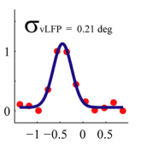
Signal/noise ratio. The signal/noise ratio of the visual spread (VS) map to determine whether or not a cell had a mappable receptive field. A higher SNR indicates that the strength of the signal is relatively stronger compared to the level of background noise.
Gaussian function fitting for visual spread of LFP and MUA. The spatial profile of visual spread, cortical spread, and visual variation were all modeled as Gaussian functions

Slide 10


Slide 11
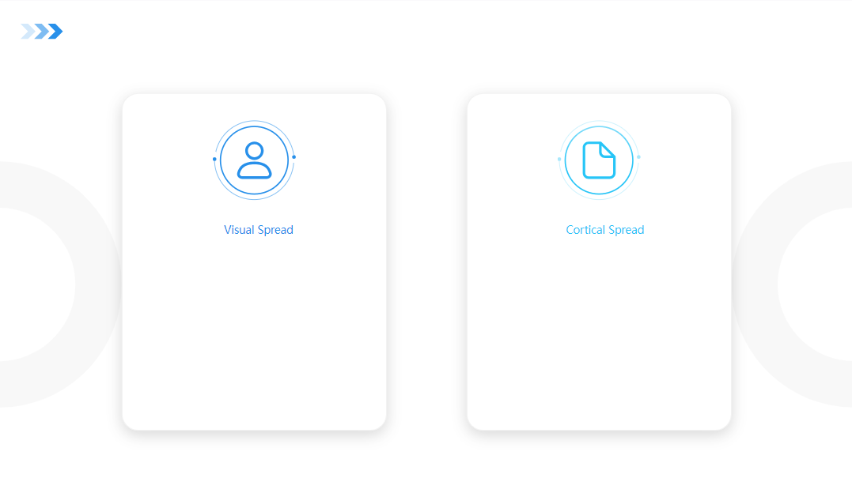
VISUAL AND CORTICAL SPREADS
The visual spread tells us how extensive is the region of visual field that can evoke an LFP at a recording site.
The cortical spread tells us how far the LFP from a source can propagate in the cortical tissue.

Slide 12
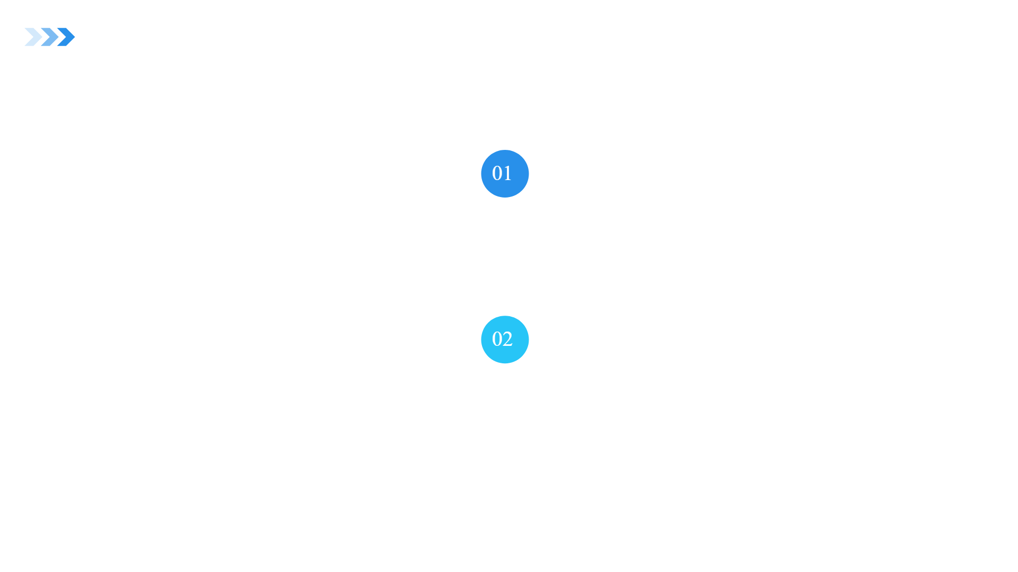
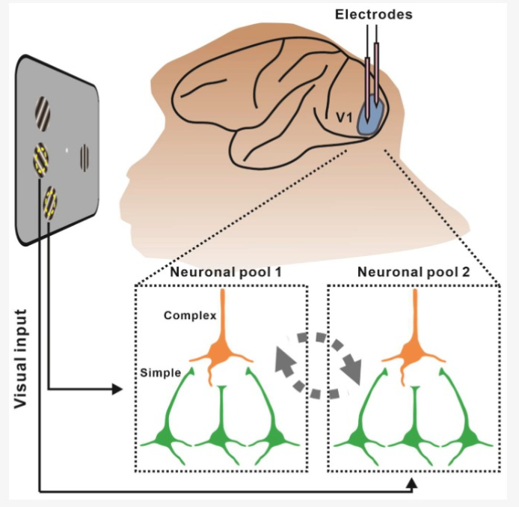
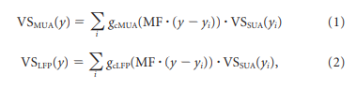
ASSUMPTIONS
The model for spatial summation in Multi-Unit Activity (MUA) and Local Field Potential (LFP) is grounded on the notion that each signal comprises the collective electrical activity of a group of neurons.
Initially, we assume precise mapping of each single cell's receptive field to a point in the visual field, with consistent visual spreads across neurons in terms of spike response and membrane potential, denoted by VSSUA(y)

Slide 13
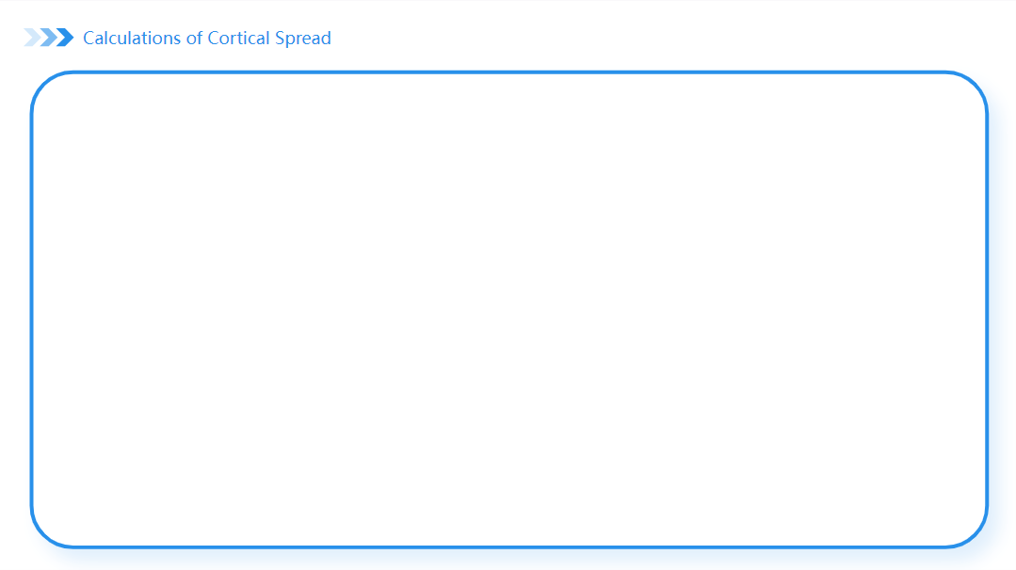
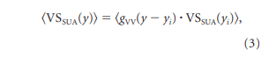

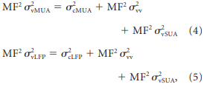
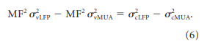
CALCULATIONS
The single cell spatial profile VSSUA(yi) is replaced with an averaged profile VSSUA(yi) over potential cell positions, approximated as Gaussian for simplicity and computational ease.
If you have two Gaussian functions a(y) and b(y) with spatial spread parameters σa and σb, then the result c(y) will be a Gaussian function with σc such that σa² + σb² = σc²

Slide 14
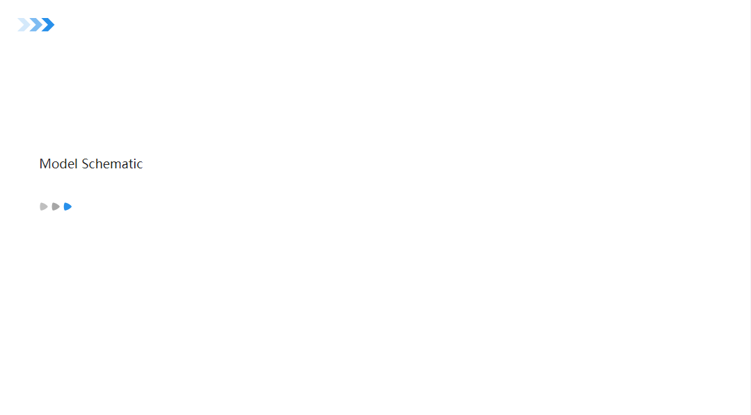
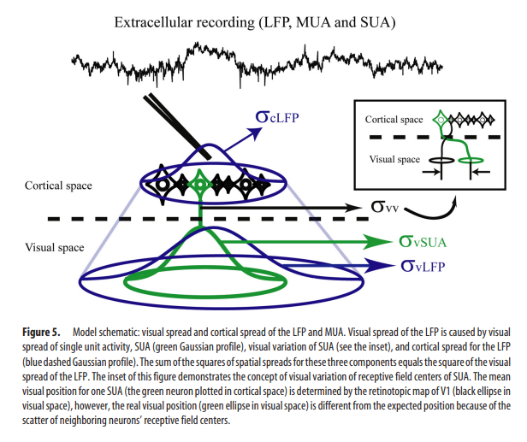
Model schematic: visual spread and cortical spread of the LFP and MUA

Slide 15
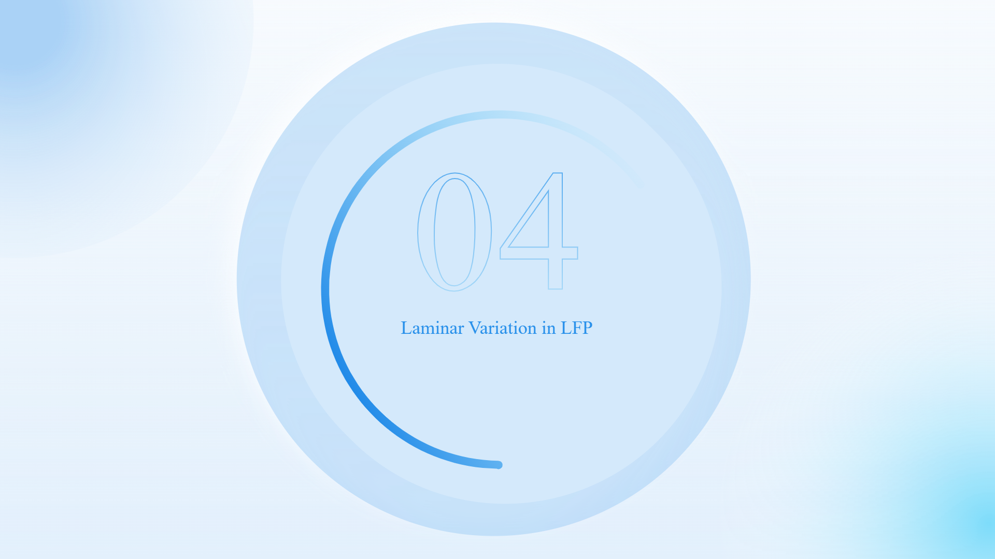


Slide 16
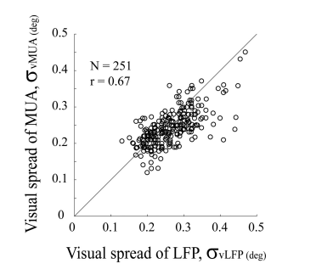
We recorded both spike activity (MUA) and field potential (LFP) with a Thomas multielectrode system in macaque V1. Data were taken from 338 recording sites in four monkeys.
This graph establishes that in V1 cortex visual spatial summation by the LFP signal is very similar to that of the spike activity recorded on the same microelectrode i.e. MUA and LFP are highly correlated.

Slide 17
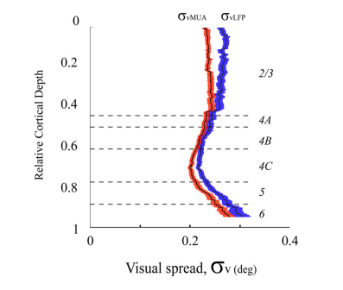
The visual spreads of LFP and MUA depended on the cortical layer in which they were recorded. Consistent with the previous graph, the dependence of visual spread on laminar location was very similar for the LFP and MUA.

Slide 18

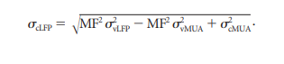
σvLFP and σvMUA is the measured activity from the electrodes. Based on these estimated magnification factors, 𝞂vLFP = 622 ± 142µm, 𝞂vMUA = 573 ± 113µm
They found that varying MUA spread within 30μm to 100μm range had no notable impact on their estimation of Local Field Potential (LFP) cortical spread.
MF was measured directly with the multi-electrode matrix. For the four monkeys, the magnification factors around the cortical projection of 5° retinal eccentricity were 2.25–2.5 mm/deg.

Slide 19
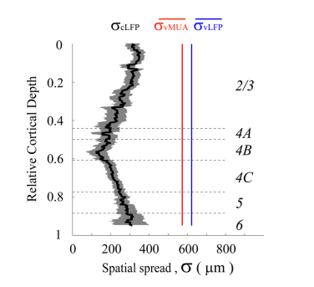
The small value (250μm ) of the mean cortical spread of the LFP across all cortical layers.
Laminar variation of LFP cortical spread between layer 4B and layer 2/3.
The relatively small value of cortical spread is one important reason why the visual spreads of MUA and LFP are so similar.

Slide 20


Slide 21
In layer 4B, the LFP on average sums from cells within a region 150 μm in radius around the recording electrode, while in layer 2/3, the extent of LFP signal summation is on average 280 μm
Laminar variation in cortical spread for LFP may be due to layer-specific impedance differences in gray matter, influenced by unique anatomical properties of each cortical depth.
Results indicated that visual spread of LFP varied across cortical layers and strongly correlated with MUA on average. This suggests that LFP can serve as a tool for studying both laminar structure and function.

Slide 22
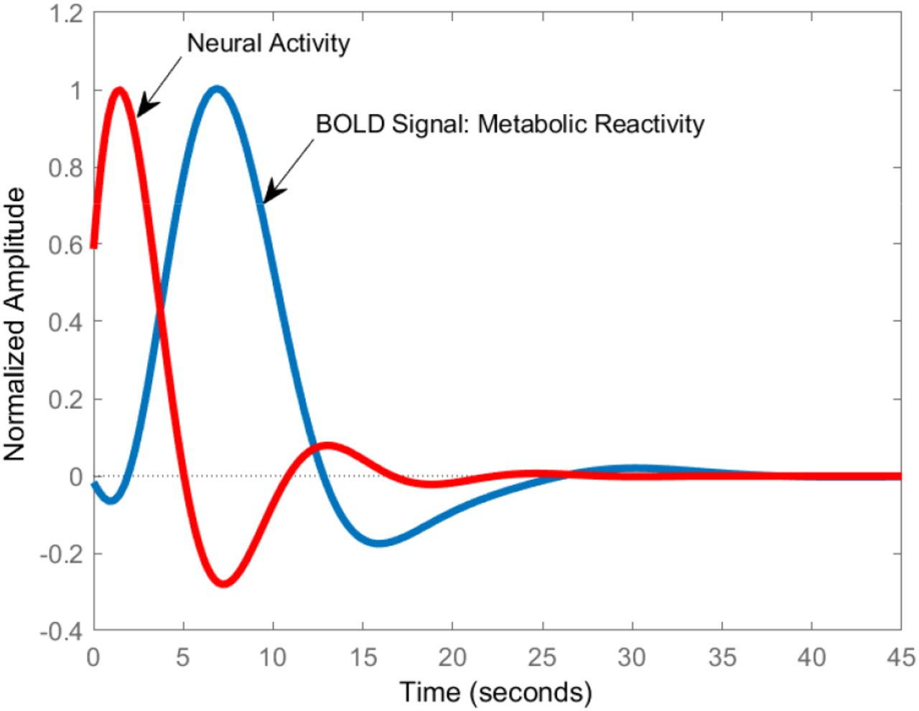
RELATIONSHIP WITH BOLD SIGNALS
Both LFP and MUA signals exhibit similar correlations with the BOLD signal due to their strong spatial correspondence.
LFPs in V1 cortex not only have good visual spatial resolution, but also the visual spreads of the spatial maps of the LFP are highly correlated, with the spatial maps of neuronal spike activity (MUA).

Slide 23
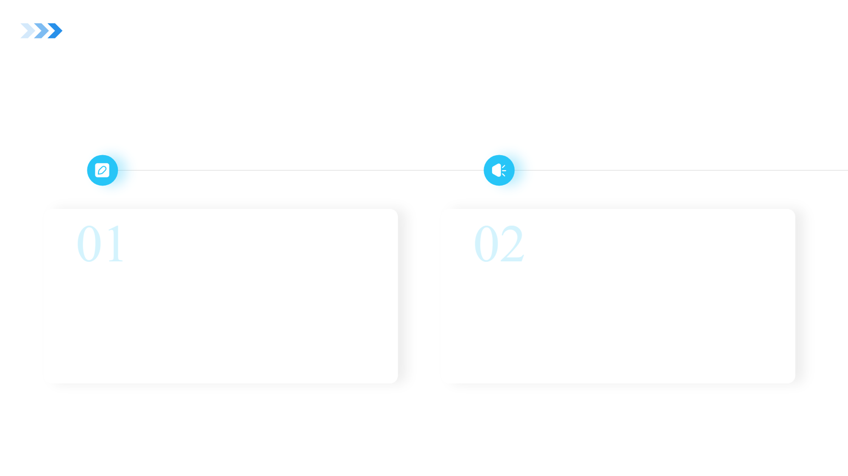
CONCLUSIONS
Provides a general method to estimate cortical spread of the LFP in any cortical area that has a topographic map. (using retinotopic map in V1). Also applied to S1 region.
The method could be extended to visual cortex where there is a retinotopic map but where there are no orientation columns.

Slide 24

FUTURE SCOPE AND IMPROVEMENTS
Current: Method for estimating the cortical spread of the LFP, combining experimental measurements with a model of signal summation.
Improvement: Enhance the method by incorporating advanced imaging techniques, to provide higher spatial resolution and more precise mapping of cortical activity.
Current: The paper explores laminar variation in the cortical spread of the LFP across different cortical layers.
Improvement: Investigate sources of variability in cortical spread across different experimental conditions, such as variations in stimulus properties, attentional states, or behavioral tasks, to better understand the factors influencing spatial integration in the visual cortex.

Slide 25
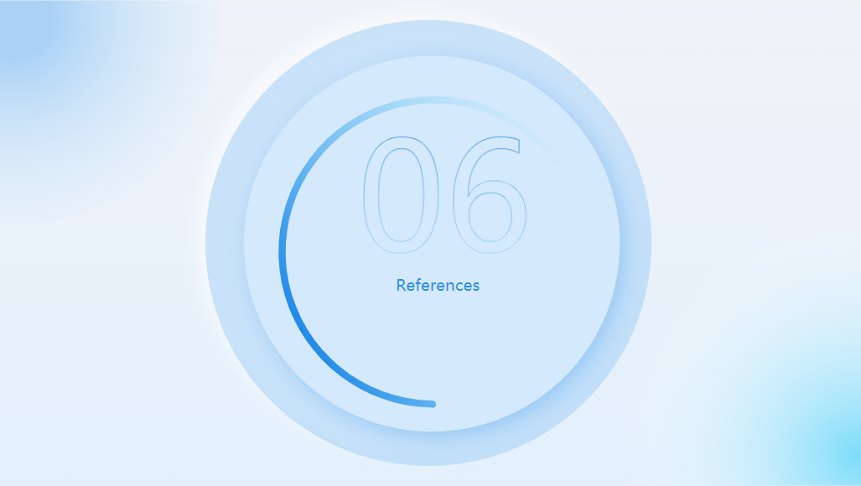

Slide 26
Xing, D., Yeh, C., & Shapley, R. (2009). Spatial Spread of the Local Field Potential and its Laminar Variation in Visual Cortex. The Journal of Neuroscience, 29(37), 11540–11549. https://doi.org/10.1523/jneurosci.2573-09.2009

Slide 27


